Slide 1

Bay-Area Environmentally Aware Consulting Network
THIMBY
December 8, 2015
Project Managers: Karthik Mayilvahanan, Karl Walter
Associate Consultants: Kathy Lee, Matthew Long, Max Morrison, Sai Sanigepalli, Tara Singh, Palak Thakur

Slide 2
Content
1
Executive Summary
2
Process
3
Research Methodologies + Data
4
Calculator
5
Conclusion
6
Questions

Slide 3
Executive Summary
Problem
Key questions:
How much carbon will be embodied in THIMBY’s tiny house?
What decisions can be made to reduce the embodied carbon in the tiny house?
Project Overview
Developed embodied carbon calculator using HTML/JS/CSS
Incorporated 73 categories and 229 products into database
Created a cheat sheet to consolidate qualitative recommendations

Slide 4





Process
Problem:
Consider embodied carbon in building materials of tiny house
Development:
Learn HTML/CSS, JS, set up framework for incorporation of embodied carbon data
Dynamic Carbon Footprint Calculator
Performs quantitative analysis of embedded carbon as well as decision support for procurement
Research:
Compilation and calculation of embodied carbon of various building materials and products
Cheat Sheet
Decision support based on qualitative information obtained during research

Slide 5
Research: Database
Methodologies
Data Collection Steps
Description
1.
Academic Papers
Numbers obtained from research papers, conferences, etc. Methodology is clear and traceable.
2.
Databases
Methodology for particular numbers not fully transparent but assumed to be consistent with boundaries as defined by the database.
3.
Component Approach
Determine materials within product.
Compile embodied carbon for each respective material using database or online source.
Perform necessary calculations.

Slide 6
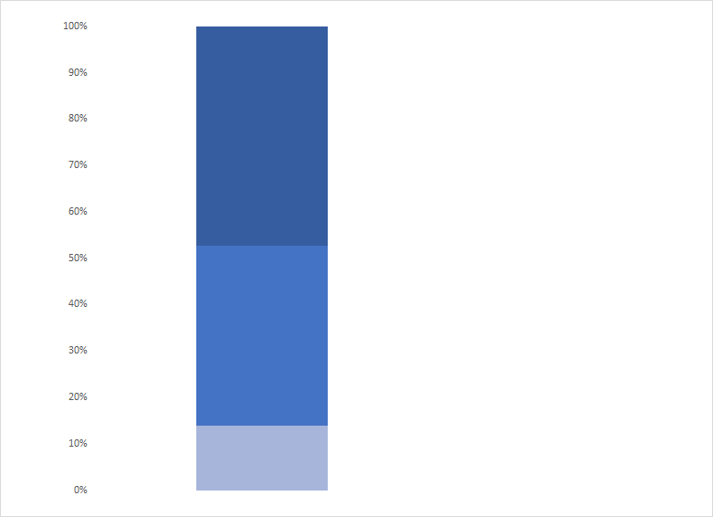
Research: Database
Validity of Sources
Number of Products
Ranking Validity of Numbers
100%
Number accounts for materials and process
Academic Articles
Raw Materials from Inventory of Carbon and Energy (ICE)
109
s
A
B
Number excludes or substitutes minor processes and/or materials
Manufactured materials extrapolated from ICE
52%
88
C
Number excludes or substitutes major processes and/or materials
Materials extrapolated from ICE
Component Method
14%
32
47% of data rated “accurate”, 38% of data rated “fair”, 14% of data rated “poor”

Slide 7
Research: Battery Comparison
Fuel For NPV Analysis
Battery Type | Total Battery Cost | Total Weight [kg] | Carbon Total [kgCO2] | Total Volume [m³] | Notes
Lead Acid | $5,815 | 585 | 667 | 0.249 | Gel batteries must be charged carefully to preserve battery life
Tesla Powerwall | $6,000 | 200 | 330 | 0.402 | Charge Controller but not inverter Included in System, $500 installation fee included in price
Used Tesla Model S | $14,400 | 75 | 330 | 0.046 | BMS must be programmed by the user, Volume only includes raw cells, DIY
Powerwall is simplest; while others allow for greater flexibility in total capacity:
Lowest Capital Cost: Lead Acid
Lowest Volume: Model S
Lowest Carbon Footprint: Model S and Powerwall

Slide 8
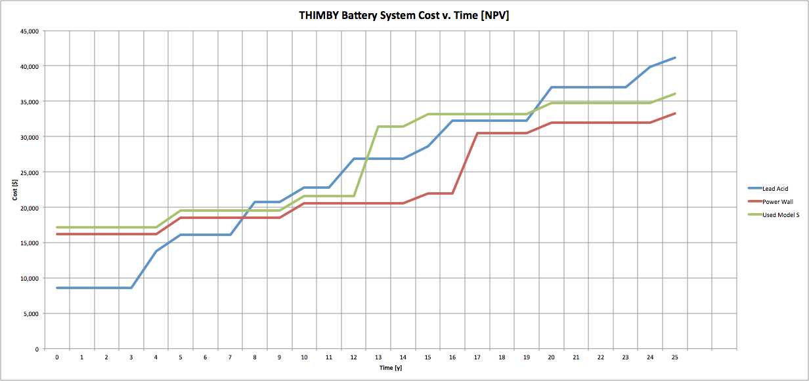
Research: Battery System Economics
Net Present Value
Battery costs are time dependent (because of system and part replacement)
Shorter Timeline: PB Acid is best
Longer Timeline: Power Wall is best

Slide 9
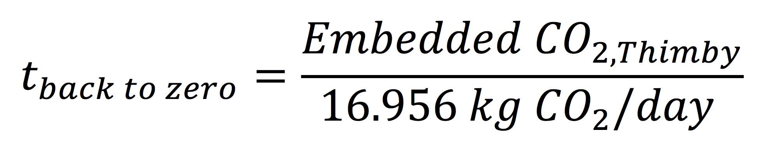
Research: Time Back to Zero
Time back to Zero refers to the time it will take for the carbon emissions of an average household to equal the embodied carbon of the tiny house. This is based off of the following equation:
Concept
Calculation of this constant incorporated electricity (PG&E), natural gas (PG&E), and propane (California EIA) usage of an average household. The value was determined to be:
16.956 kg CO2/day saved
Constant
The time back to zero is calculated as shown on the right. If the time spent living in the house exceeds the
Calculation
time back to zero, building the tiny house from scratch was a “green decision” compared to living in an “average” house.
Time back to zero quantifies the embodied carbon “savings” of living in a tiny house, and is incorporated directly into the calculator.

Slide 10
Calculator
Instructions
Steps
Choose desired aspect of house from tabs at top of page (Electrical, Plumbing, Interior, Exterior, Structure
1
Choose desired category from sidebar
2
Choose desired subcategory from drop down menu of the category
3
Enter an amount of the desired material in the input box
4
Choose the desired product from a list of provided options in the select drop down menu
5
Hit “Submit” to add the carbon footprint of the chosen option to the running “Tiny House Carbon Footprint” total
6
Repeat for all other materials

Slide 11
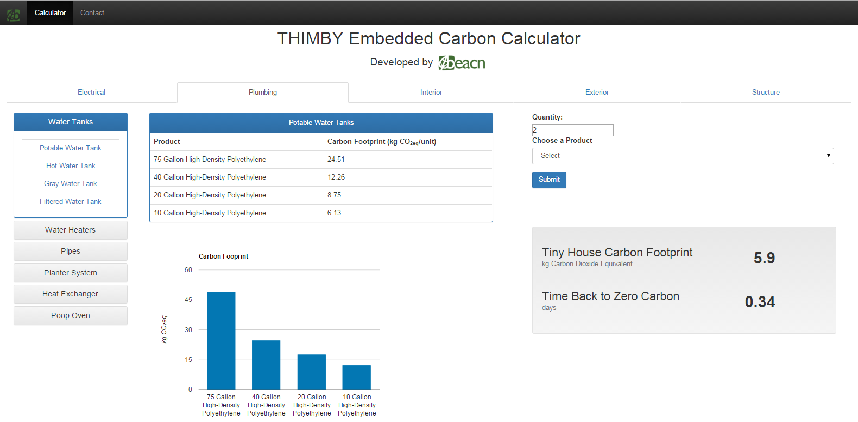
Calculator
Demonstration

Slide 12

Conclusion
Limitations and Improvements
Materials Uncertainty
Cannot account for all possible materials used in all aspects of the home.
Solution
The calculator and database are dynamic.
New material and/or new data values may be added.
Number Quality
Values determined using the component approach have a fairly high degree of uncertainty.

Slide 13

Conclusion
SMUD Criteria
 | Category | Points | Comments
3 | Home Life | 200 | Provide a safe and functional home, meeting the needs of the targeted client and the final environment of the house. Efficient use of recycled and repurposed materials in construction. Sustainable management of water, waste
4 | Communication | 200 | Printed and digital documentation of the complete process of building the house: photos, receipts, schematics, budgets, letters of support and the energy balance documentation. Documents will reflect the final destination environment while providing a cohesive thematic approach.
BEACN’s work contributes to both the environmental and competitive goals of THIMBY. This project helps THIMBY to stand out from the competition due to its carbon accounting.

Slide 14
Q&A

